Slide 1
Customer Segmentation Analysis Report​
Subject: Analysis of Mall Customer Data using K-Means Clustering
By- anshul jangra

Slide 2
1. Introduction
In modern retail businesses, understanding customer behavior is essential for targeted marketing, personalized recommendations, and business growth. Customer segmentation divides customers into groups with similar characteristics, enabling companies to design tailored marketing strategies.
This project applies K-Means Clustering, an unsupervised machine learning technique, to segment customers based on their Annual Income and Spending Score using the Mall Customers Dataset.
The goal is to identify distinct customer groups that can help in strategic decision-making

Slide 3
​2. Data Overview & Preprocessing​
The dataset consists of 200 records with the following attributes:​
CustomerID: Unique identifier
​Gender: Categorical (Male/Female)
​Age: Numeric
​Annual Income (k$): Numeric
​Spending Score (1-100): Numeric
​Preprocessing Steps:
​Data Integrity: The dataset was inspected for missing values. No null values were found (0 nulls in all columns).
​Feature Selection: The analysis focused on two key metrics for segmentation:​
Annual Income (k$)​
Spending Score (1-100)​
Dataset Shape: 200 rows, 5 columns

Slide 4
3. Methodology
Determination of Optimal Clusters​To ensure the grouping was mathematically sound, two methods were employed to find the optimal number of clusters (k).​
3.1 The Elbow Method
​The Within-Cluster Sum of Squares (WCSS) was calculated for cluster counts ranging from 1 to 10.
​Observation: The "Elbow Point Graph" showed a sharp decline in WCSS from 1 to 5 clusters, after which the curve flattened significantly.
​Conclusion: The elbow point was clearly identified at k=5.

Slide 5
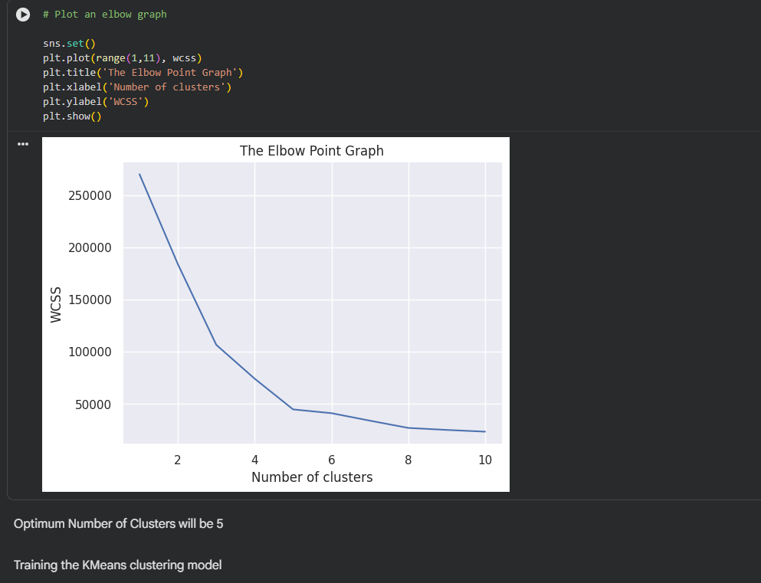

Slide 6
​3.2 Silhouette Analysis
​Silhouette scores were calculated to measure how similar a point is to its own cluster compared to other clusters.
​Results:​
k=2: 0.396​
k=3: 0.468
​k=4: 0.494​
k=5: 0.554 (Highest Score)
​k=6: 0.539
​Conclusion: A score of 0.554 indicates a relatively strong structure. The silhouette plot for k=5 confirms that all clusters have above-average silhouette coefficients, indicating well-separated groups.

Slide 7
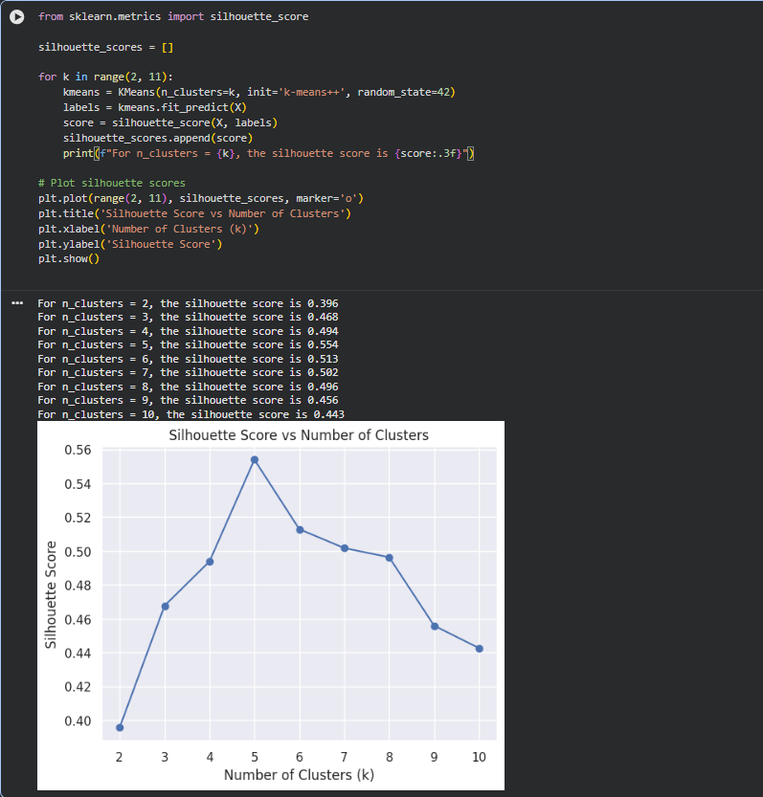

Slide 8
​4. Cluster Analysis & Interpretation​
Based on the visualization of the 5 clusters (Green, Red, Blue, Yellow, Black), we have identified the following distinct customer personas:
cluster | Visual color (approx) | Characteristics | Persona name | Marketing strategy
Cluster 1 | Green (center) | Mid Income, Mid Spending | "Standard Customers" | Focus on loyalty programs and standard promotions to maintain engagement
Cluster 2 | Red (top right) | High Income, High Spending | "The Elite / Target" | Prime targets for luxury goods, VIP services, and exclusive offers. Most profitable segment
Cluster 3 | Blue (bottom right) | High Income, Low Spending | "Frugal Earners" | Potential for upselling. Marketing should focus on value proposition and quality to unlock their spending power.
Cluster 4 | Yellow (bottom left) | Low Income, Low Spending | "Budget Conscious" | Focus on discounts, sales events, and budget-friendly products.
Cluster 5 | Black (top left) | Low Income, High Spending | "Impulse Buyers" | Likely younger demographic. Focus on trendy items, limited-time offers, and "buy now" appeals.

Slide 9
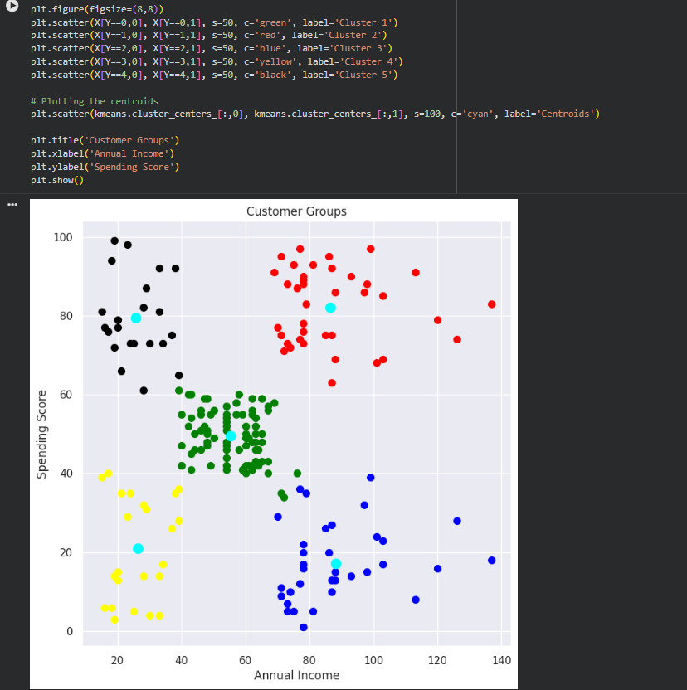

Slide 10
5. Objective of the Project
The primary objectives of this project are:
To analyze demographic and financial characteristics of mall customers.
To determine the optimal number of customer segments.
To apply K-Means clustering to create meaningful customer groups.
To visualize clusters and interpret customer behavior.
To evaluate clustering quality using the Elbow Method and Silhouette Score.

Slide 11
6. Visual Validation​Scatter Plot:
The scatter plot clearly shows 5 distinct regions with minimal overlap, validating the choice of k=5.​Silhouette Plot: The vertical thickness of the silhouette plots suggests that the "Standard Customers" (Cluster 1) is the largest group, while the outliers (High Income/Low Spend) form smaller, distinct niches.

Slide 12
​7. Conclusion
​The K-Means clustering model successfully categorized the mall customers into actionable groups. By tailoring marketing campaigns to the five personas identified—specifically targeting the "Elite" for high-margin items and the "Impulse Buyers" for volume sales—the mall can optimize its revenue strategies

